Slide 1

Algebra 1
Unit 9, Lesson 2 Writing a Quadratic Function From a Graphic Volume 2, pg. 65

Slide 2


Benchmarks
MA.912.AR.1.2
Rearrange equations or formulas to isolate a quantity of interest.
MA.912.AR.3.4
Write a quadratic function to represent the relationship between two quantities from a graph, a written description, or a table of values within a mathematical or real-world context.
volume 2, pg. 65

Slide 3
Integrated Mathematical Thinking and Reasoning Standards
MA.K12.MTR.2.1 Demonstrate understanding by representing problems in multiple ways.
MA.K12.MTR.3.1 Complete tasks with mathematical fluency.
MA.K12.MTR.4.1 Engage in discussions that reflect on the mathematical thinking of self and others.
MA.K12.MTR.5.1 Use patterns and structure to help understand and connect mathematical concepts.
volume 2, pg. 65

Slide 4

Learning Targets
I can write a quadratic function to represent the relationship between two quantities from a graph.
I can rewrite a quadratic equation from vertex form to standard form.
I can solve for a variable of interest.
volume 2, pg. 65

Slide 5

Warm-Up
volume 2, pg. 65

Slide 6
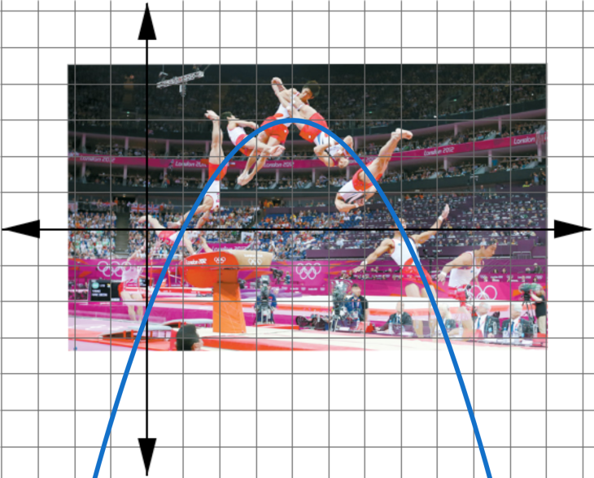
9.2.1 Warm-Up: Vaulting Moves
Vaulting is an exercise in which gymnasts leap over an apparatus and perform a skill in mid-air. The image shows a frame-by-frame pictorial of a gymnast’s vault routine. Based on the compilation of moves performed by the gymnast, a sketch of a parabola was drawn.
volume 2, pg. 65
Notes:
Video Link: https://algebranation.wistia.com/medias/fi4fidi5y8

Slide 7
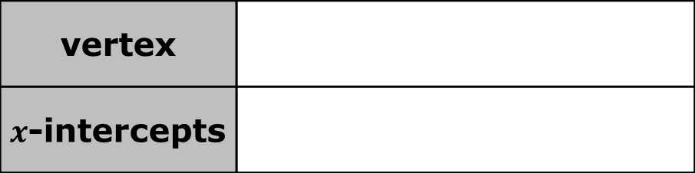
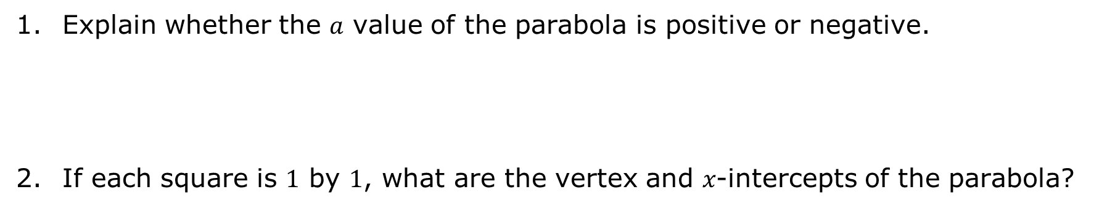
Explain whether the 𝑎 value of the parabola is positive or negative.
If each square is $1$ by $1$, what are the vertex and 𝑥-intercepts of the parabola?
vertex
$x$-intercepts
volume 2, pg. 65

Slide 8

Guided Instruction
volume 2, pg. 66

Slide 9

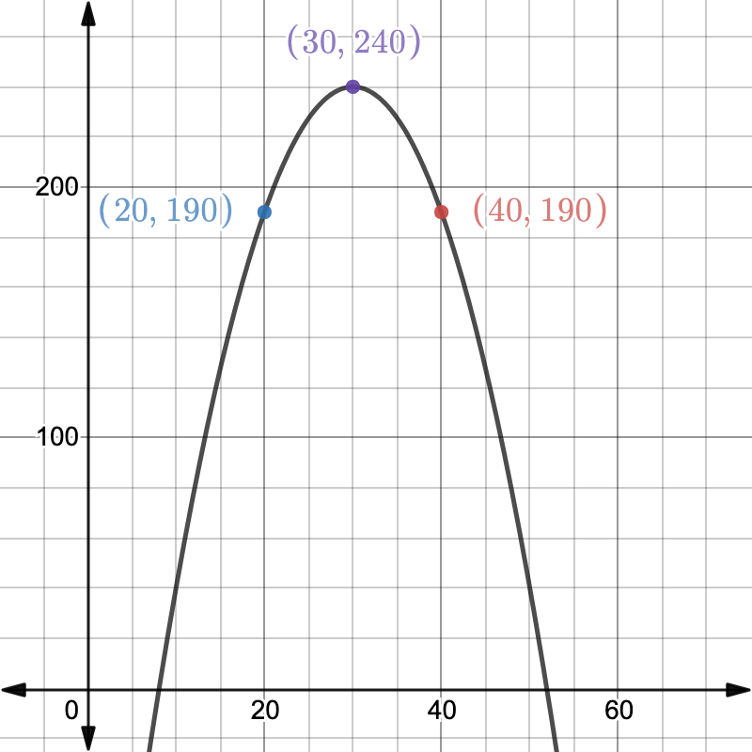
9.2.2 Guided Instruction: Writing a Quadratic Function in Vertex Form from a Graph
Hudson is starting a lawn-mowing business in his neighborhood. He creates a graph to help him determine what to charge customers per mow to maximize his profits. He uses 𝑥 to represent the cost of each lawn he mows and 𝑦 to represent the profit in dollars ($).
volume 2, pg. 66

Slide 10
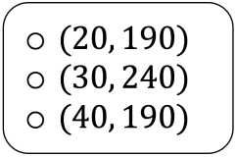
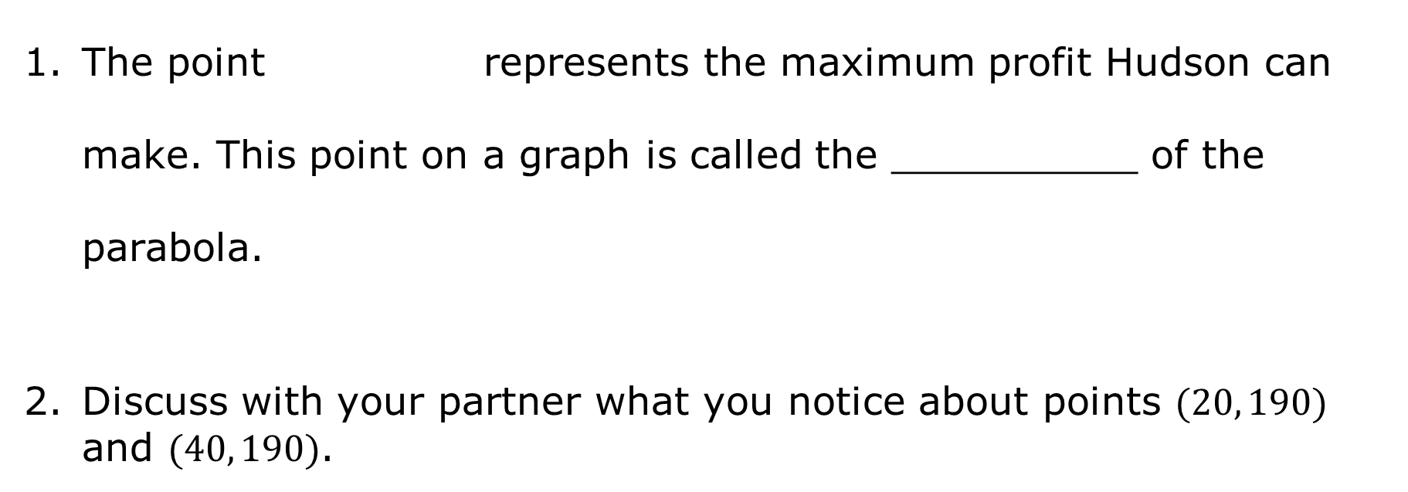
The point represents the maximum profit Hudson can make. This point on a graph is called the __________ of the parabola.
Discuss with your partner what you notice about points $(20, 190)$ and $(40, 190)$.
volume 2, pg. 66

Slide 11
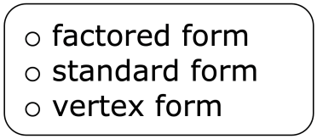
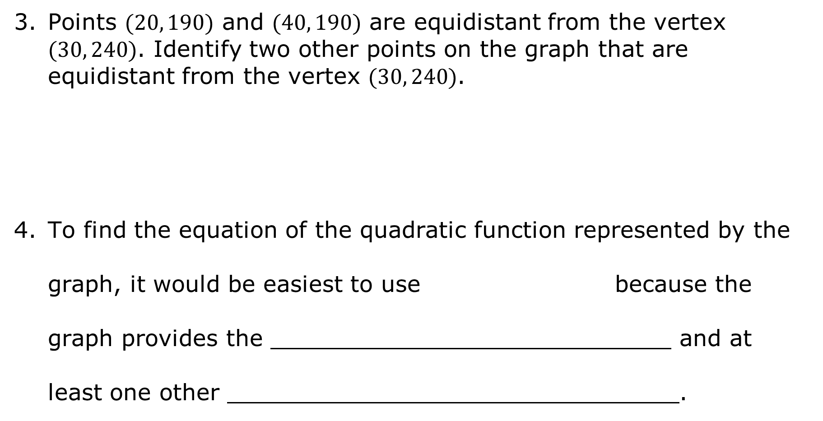
Points $(20, 190)$ and $(40, 190)$ are equidistant from the vertex $(30, 240)$. Identify two other points on the graph that are equidistant from the vertex $(30, 240)$.
To find the equation of the quadratic function represented by the graph, it would be easiest to use because the graph provides the and at least one other .
volume 2, pg. 66

Slide 12

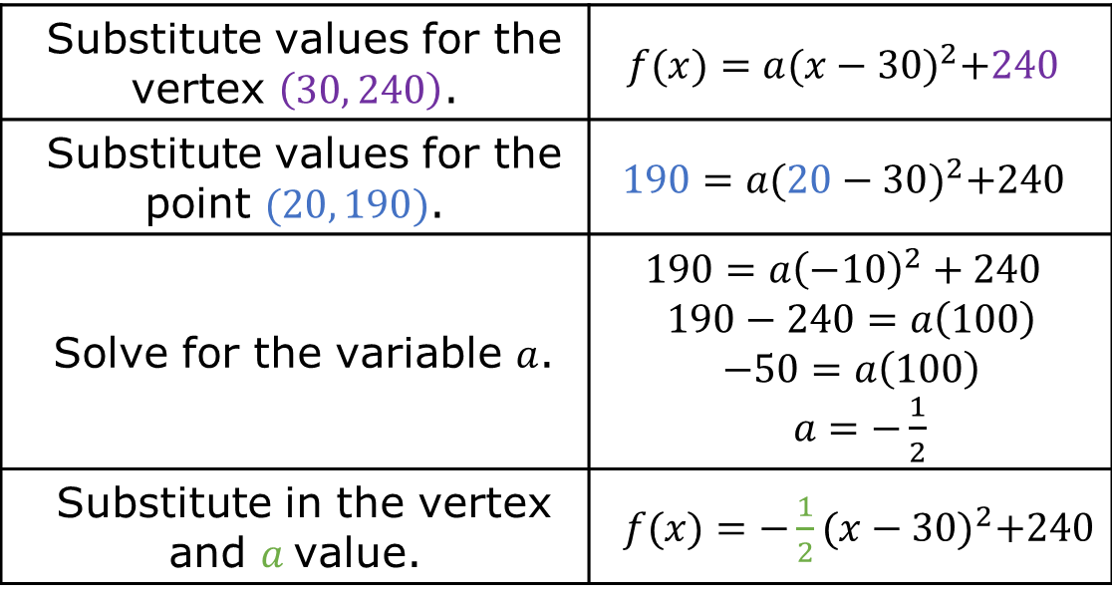
The steps in the table show how to use the point $(20, 190)$ and the vertex $(30, 240)$ to find the quadratic function in vertex form $f(x)=a{\left(x−h\right)}^{2}+k$, where $(h, k)$ is the vertex.
The quadratic equation Hudson graphed is $y=−\frac{1}{2} {\left(x−30\right)}^{2}+240$.
Substitute values for the vertex $\left(30, 240\right)$. | $$f(x)=a{(x−30)}^{2}+240$$
Substitute values for the point $(20, 190)$. | $$190=a{(20−30)}^{2}+240$$
Solve for the variable $a$. | $$190=a{\left(−10\right)}^{2}+240$$ $$190−240=a\left(100\right)$$ $$−50=a\left(100\right)$$ $a=−\frac{1}{2}$
Substitute in the vertex and $a$value. | $f(x)=−\frac{1}{2}{(x−30)}^{2}+240$
volume 2, pg. 67

Slide 13

Collaboration
volume 2, pg. 67

Slide 14

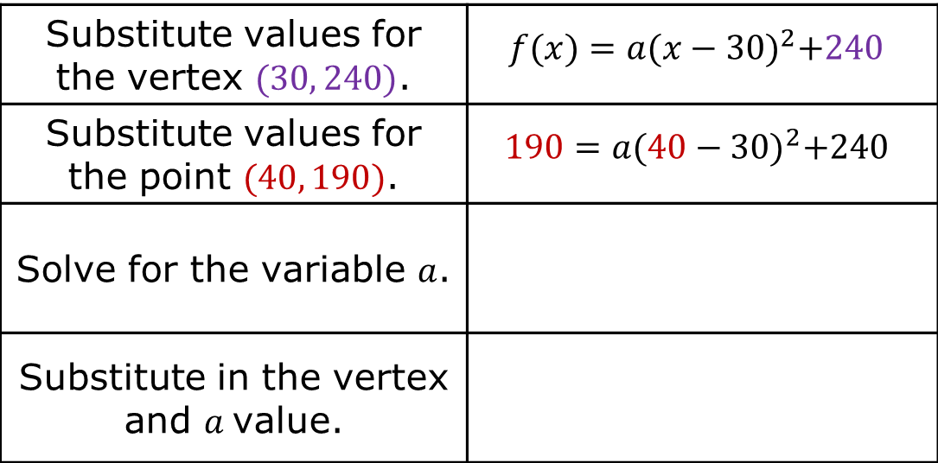
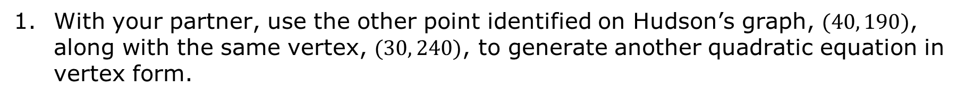
9.2.3 Collaboration: Writing a Quadratic Function Using a Vertex and Point From a Graph
With your partner, use the other point identified on Hudson’s graph, $(40, 190)$, along with the same vertex, $(30, 240)$, to generate another quadratic equation in vertex form.
Substitute values for the vertex $(30, 240)$. | $$f(x)=a{(x−30)}^{2}+240$$
Substitute values for the point $(40, 190)$. | $$190=a{(40−30)}^{2}+240$$
Solve for the variable $a$.
Substitute in the vertex and $a$value.
volume 2, pg. 67

Slide 15
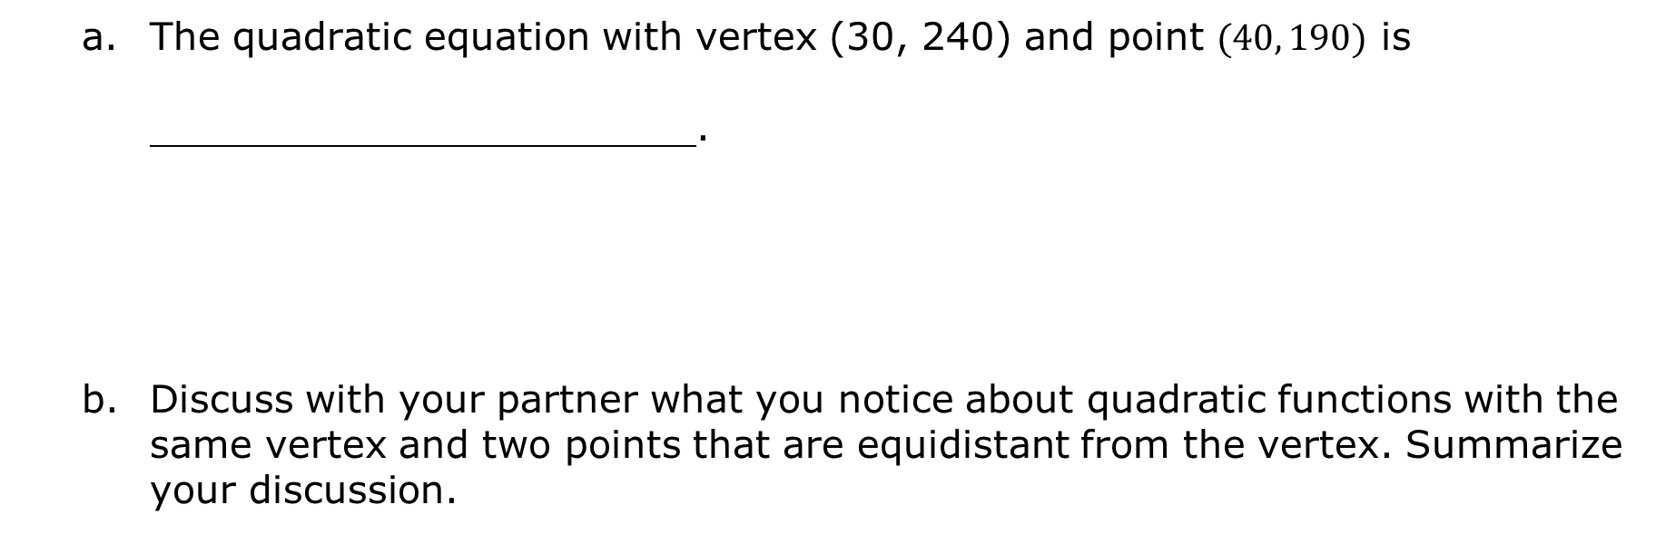
The quadratic equation with vertex (30, 240) and point $(40, 190)$ is .
Discuss with your partner what you notice about quadratic functions with the same vertex and two points that are equidistant from the vertex. Summarize your discussion.
volume 2, pg. 67

Slide 16
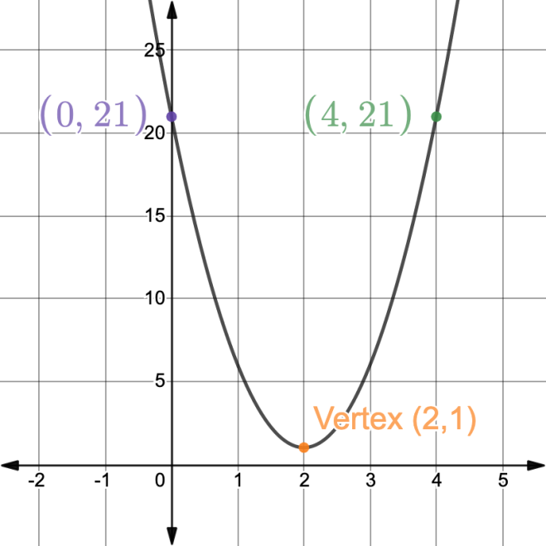
A quadratic function is graphed with the vertex and two points equidistant from the vertex labeled.
volume 2, pg. 68

Slide 17
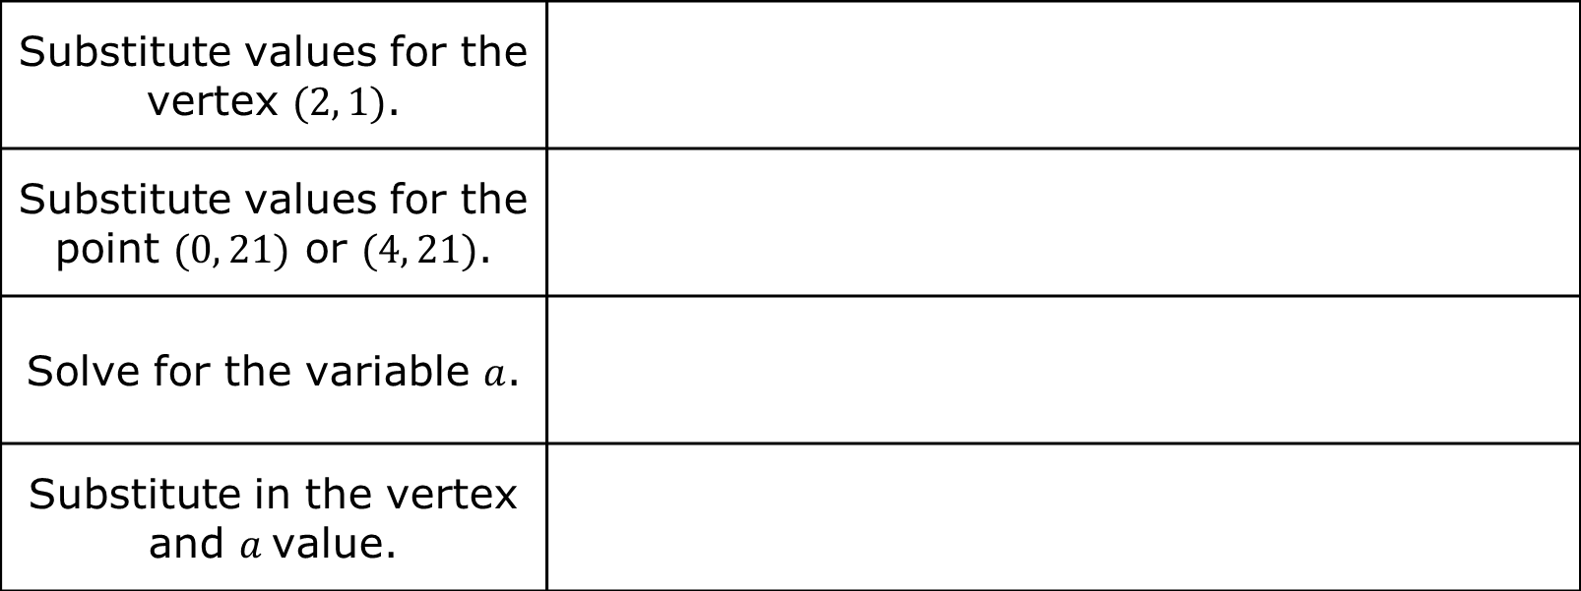
Write the equation in vertex form for the quadratic function graphed.
Substitute values for the vertex $(2, 1)$.
Substitute values for the point $(0, 21)$ or $(4, 21)$.
Solve for the variable $a$.
Substitute in the vertex and $a$value.
volume 2, pg. 68

Slide 18
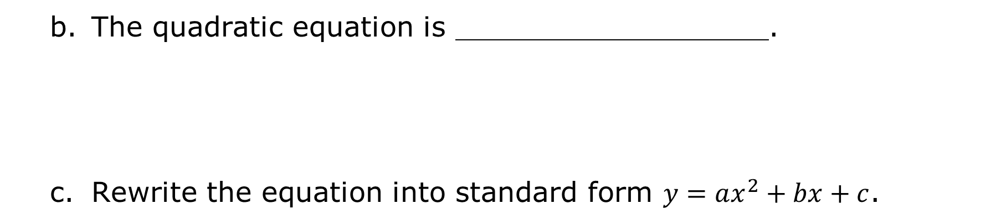
The quadratic equation is .
Rewrite the equation into standard form $y=ax^{2}+bx+c$.
volume 2, pg. 68

Slide 19
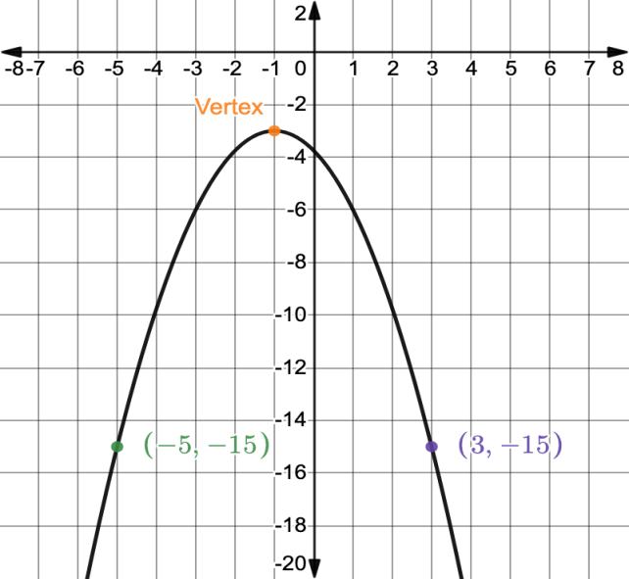
Write the quadratic equation for the graph.
Vertex Form
Standard Form
volume 2, pg. 68

Slide 20

Your Turn
volume 2, pg. 69

Slide 21
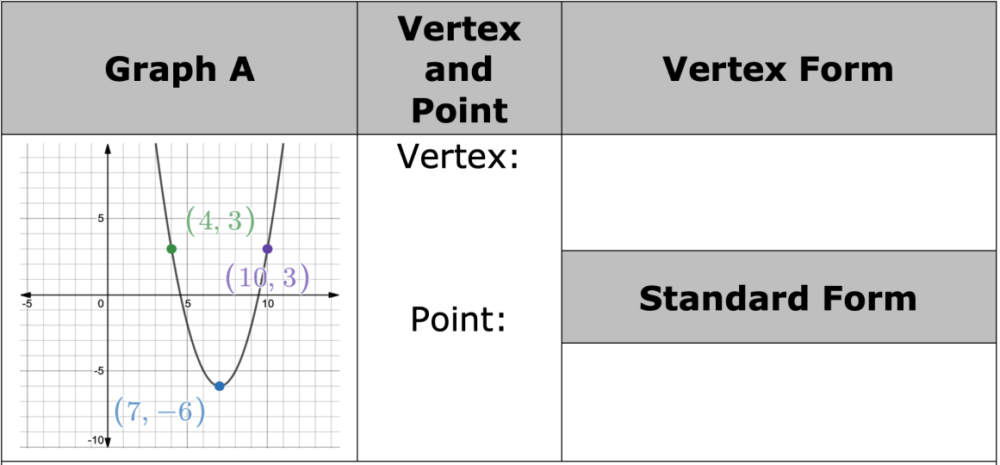
9.2.4 Your Turn!
Complete the table for each quadratic function using the graph of the function.
volume 2, pg. 69

Slide 22
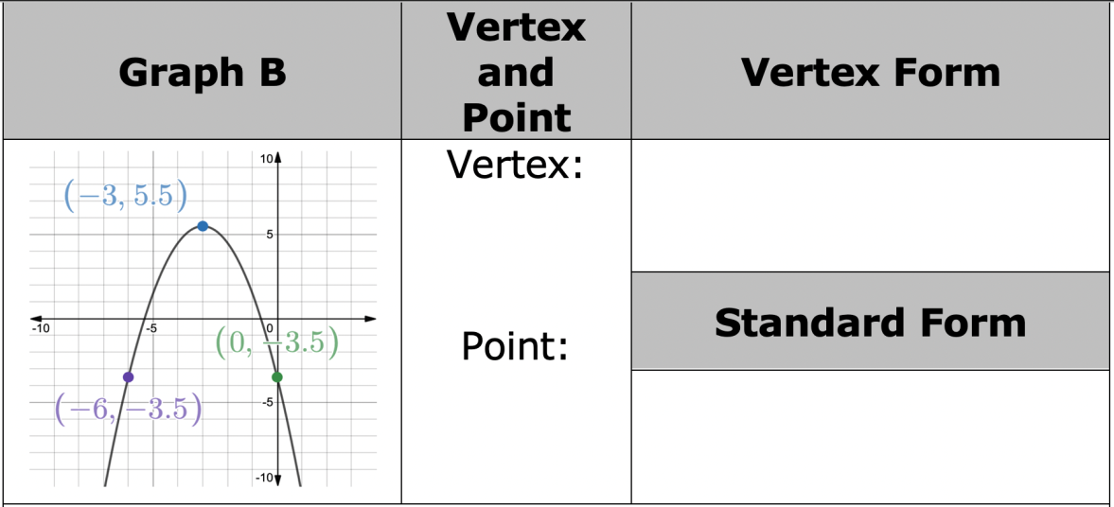
volume 2, pg. 69

Slide 23
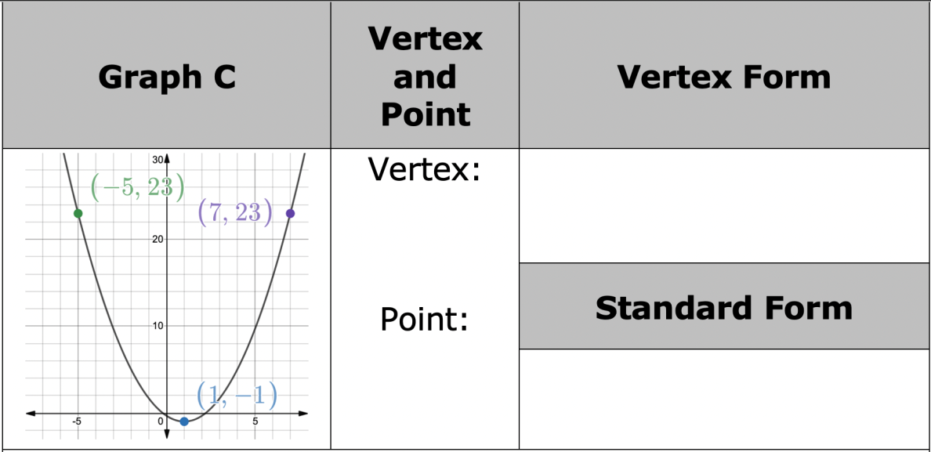
volume 2, pg. 70

Slide 24

Wrap-Up
volume 2, pg. 70

Slide 25

9.2.5 Wrap-Up: Reflection
How “in the zone” do you feel right now about your understanding of writing equations of quadratic functions?
volume 2, pg. 70

